Slide 1
WELCOME To Hack J On The Beach!
#JOTB17 @JOTB17

Slide 2
The Hackathon
Our host company, Valo, in collaboration with Globalcode, are proud to present this hackathon, which will bring the worlds of Big Data and IoT together to hack the J on The Beach event.

Slide 3
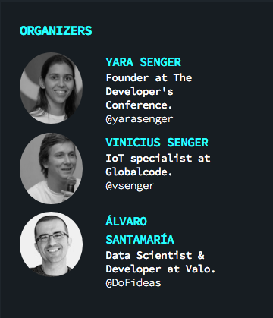

Slide 4
The Goal
To learn and to apply new technologies
to apply to J On The Beach better,
as well as your own carrier
and also to any other solution you may find in the future to improve the world in any way.

Slide 5
The Agenda Lot's of things to learn and
experiences to live.
Come together!

Slide 6
10:30 - 11:00 | Breakfast
11:00 - 13:00 | Valo Workshop, Alvaro Santamaría
13:00 - 13:30 | Data Visualization and ingestion with Twitter and Philips Hue
13:30 - 14:30 | Lunch time
14:30 - 15:45 | Arduino, IoT Surfboard, Node-RED & MQTT, Vinicius Senger
15:45 - 16:30 | Data Visualization with HTML and JavaScript, Danilo Rossi
16:30 - 17:00 | Coffee-break
17:00 - 18:00 | Brainstorm, project ideation and team building
18:00 - 19:00 | Voice assistant Demos and discussion

Slide 7
18, May | Hack J On The Beach
8:00 - 9:00 | Registration
9:00 - 10:10 | Keynote Evolving Quantum Computers
10:30 - 11:00 | Breakfast
11:00 - 13:30 | Hacking time
13:30 - 14:30 | Lunch time
14:30 - 16:45 | Hacking time
16:20 - 16:40 | Coffee-break
16:40 - 17:40 | Hacking time
17:40 - 18:30 | Keynote Dynamic data visualization | Hacking time
18:30 - 21:00 | Beer and Pizza time | Hacking time

Slide 8
19, May | Hack J On The Beach
8:00 - 9:00 | Registration
9:00 - 10:10 | Hacking time
10:30 - 11:00 | Breakfast
11:00 - 13:30 | Presentation rehearsal with each team
13:30 - 14:30 | Lunch time
14:30 - 16:45 | Presentation of the hackathon projects
16:20 - 16:40 | Coffee-break
16:40 - 18:30 | You can go to the talks
18:30 - 19:00 | Hackathon Awards
19:00 - 00:00 | Party Sponsored by JElastic

Slide 9
The Rules
to learn
to be collaborative
to be creative
to share
and of course, to have FUN!
Notes:
Learn during the workshops
Be collaborative and comitted to your team and all the participants at the hackathon
To share what you have done by presenting and sharing the knowledge in the near future

Slide 10
Formal Rules
All the code should be published with MIT License
Describe your project and the team in the readme file in the github inside the teams folders.
Every team should present the project on Friday
If you are not participating Thursday and Friday please make clear you are not coming next days
You can attend the keynotes Thursday and talks Friday afternoon as organizers, it means we should let the JOTB attendees sit first.
Teams should be around 4 people and max 6

Slide 11
Criteria
Innovation / business / social impact
Relevance of Internet of Things
Relevance of Real Time Analytics
Working prototype / technical specification
Presentation

Slide 12
Jury
Santiago Ortiz
Antony Perkov
Luis Sanchez
Manthan Dave
Carmel Hassam

Slide 13
Introduce yourself
Don't be shy
Tell more about your tech skills
Tell us where did you come from
What are your expectations at this Hackathon
Let us know if you have participated on other Hackathons

Slide 14
#JOTB17 #Hackathon
Thank you!
See you soon!

Slide 15
Brainstorm, ideation and team building

Slide 16
The Goal
Discuss how everything you have learned today
can be applied to hack J On The Beach
and create teams based on the ideas that are more interesting for each of you

Slide 17
What could be different at JOTB?
Registration and check in
Lunch, coffee-breaks and party
Sponsors exhibition
Feedback
Networking with other participants

Slide 18
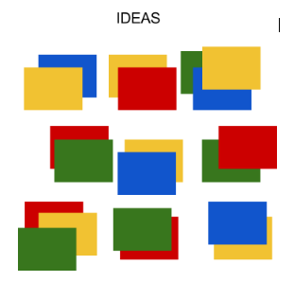
Part 1:
There are 3 mentors in 3 tables
Pick a sit in one of those tables for the first discussion round that takes 5 minutes
One person should write down the ideas
Notes:
Learn during the workshops
Be collaborative and comitted to your team and all the participants at the hackathon
To share what you have done by presenting and sharing the knowledge in the near future

Slide 19
About brainstorming
Never criticize ideas immediately
Ideas are no ones property
No idea is kept from the group, brainstorm is about quantity
Be brief formulating short and accurate ideas
Absorb the ideas of others
Notes:
http://www.tricider.com/Brainstorming-Rules

Slide 20
Part 2:
Sit in another table avoiding to keep exactly the same group and repeat the process.
Notes:
Learn during the workshops
Be collaborative and comitted to your team and all the participants at the hackathon
To share what you have done by presenting and sharing the knowledge in the near future

Slide 21
Part 3:
Sit in another table avoiding to keep exactly the same group and repeat the process.
Notes:
Learn during the workshops
Be collaborative and comitted to your team and all the participants at the hackathon
To share what you have done by presenting and sharing the knowledge in the near future

Slide 22
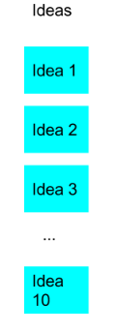
Part 4:
Mentors are going to organize the board and try to group the related ideas.
Mentors are going to select the ideas that they like more as a suggestion only.
Notes:
Learn during the workshops
Be collaborative and comitted to your team and all the participants at the hackathon
To share what you have done by presenting and sharing the knowledge in the near future

Slide 23
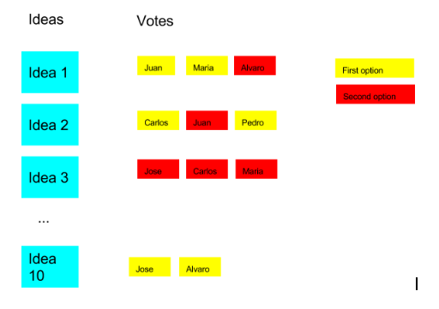
Part 5:
Participants add their votes on the ideas they like more,
using posits according their
background.
Participants can change votes until teams reach the minimum size
Notes:
Learn during the workshops
Be collaborative and comitted to your team and all the participants at the hackathon
To share what you have done by presenting and sharing the knowledge in the near future

Slide 24
Thank you!
See you soon!

Slide 25
Presentations of J On The Beach Hackathon Projects

Slide 26
The Hackathon
Our host company, Valo, in collaboration with Globalcode, are proud to present this hackathon, which will bring the worlds of Big Data and IoT together to hack the J on The Beach event.

Slide 27
The Goal
To learn and to apply new technologies
to apply to J On The Beach better,
as well as your own carrier
and also to any other solution you may find in the future to improve the world in any way.

Slide 28
Thanks to
Luis Sanchez
Alvaro Santamaría
Danilo Rossi
Zurisadai Pabón
Andrés Ramírez
Andras Keskces
Ana Arjona
and all the Valo the team!

Slide 29
Jury
Santiago Ortiz
Antony Perkov
Luis Sanchez
Manthan Dave
Carmel Hassam

Slide 30
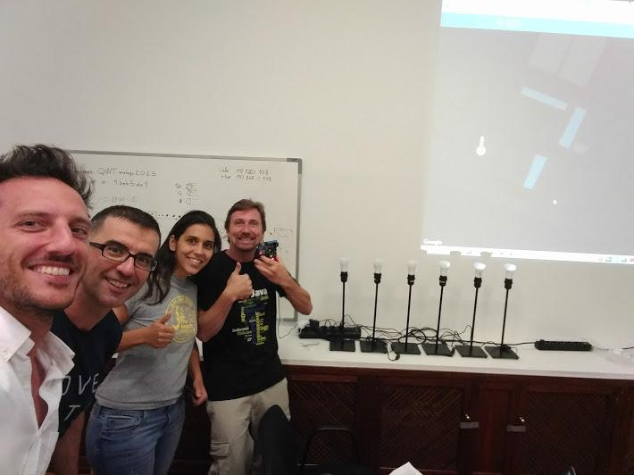
Preparation

Slide 31
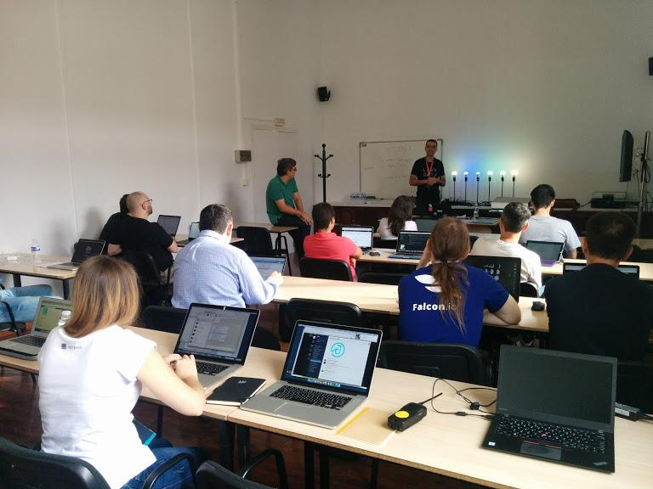
Valo Workshop

Slide 32
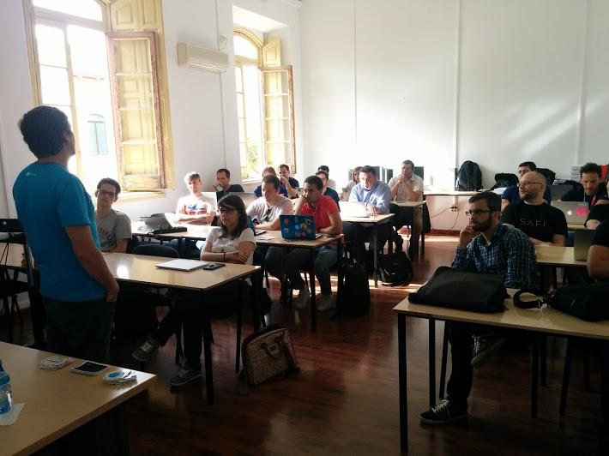
IoT Workshop

Slide 33
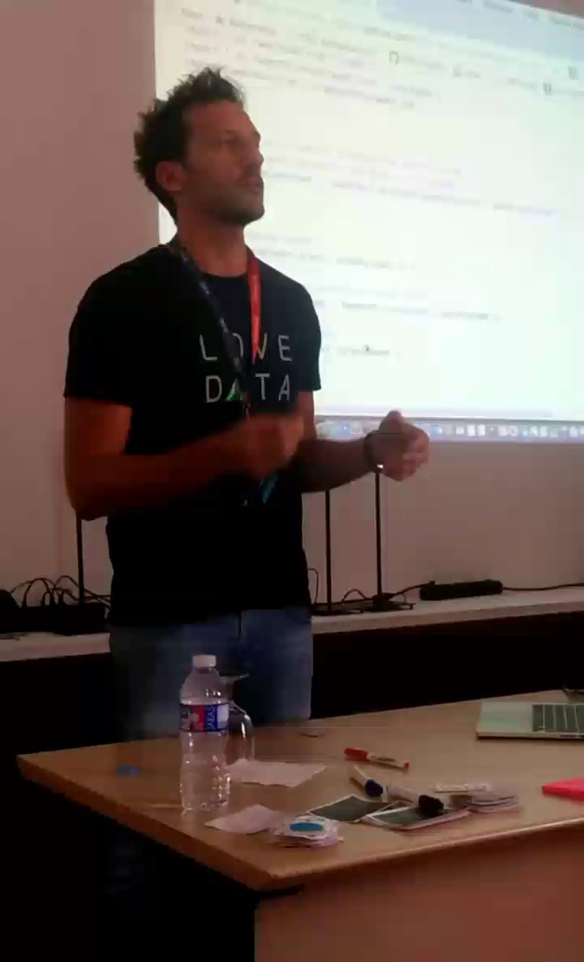
Visualization Workshop in Italian

Slide 34
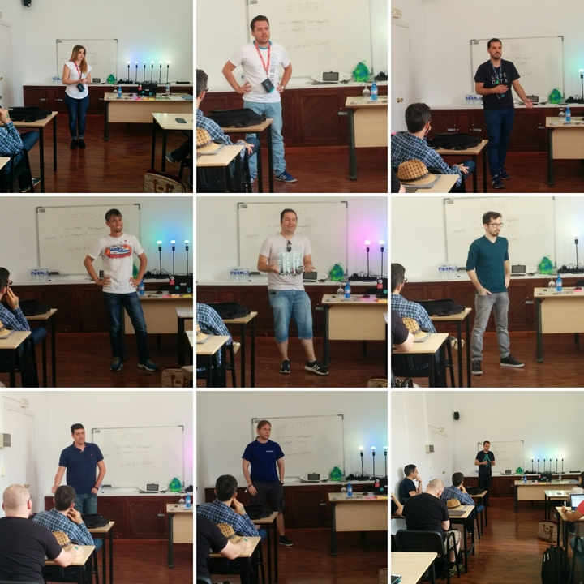
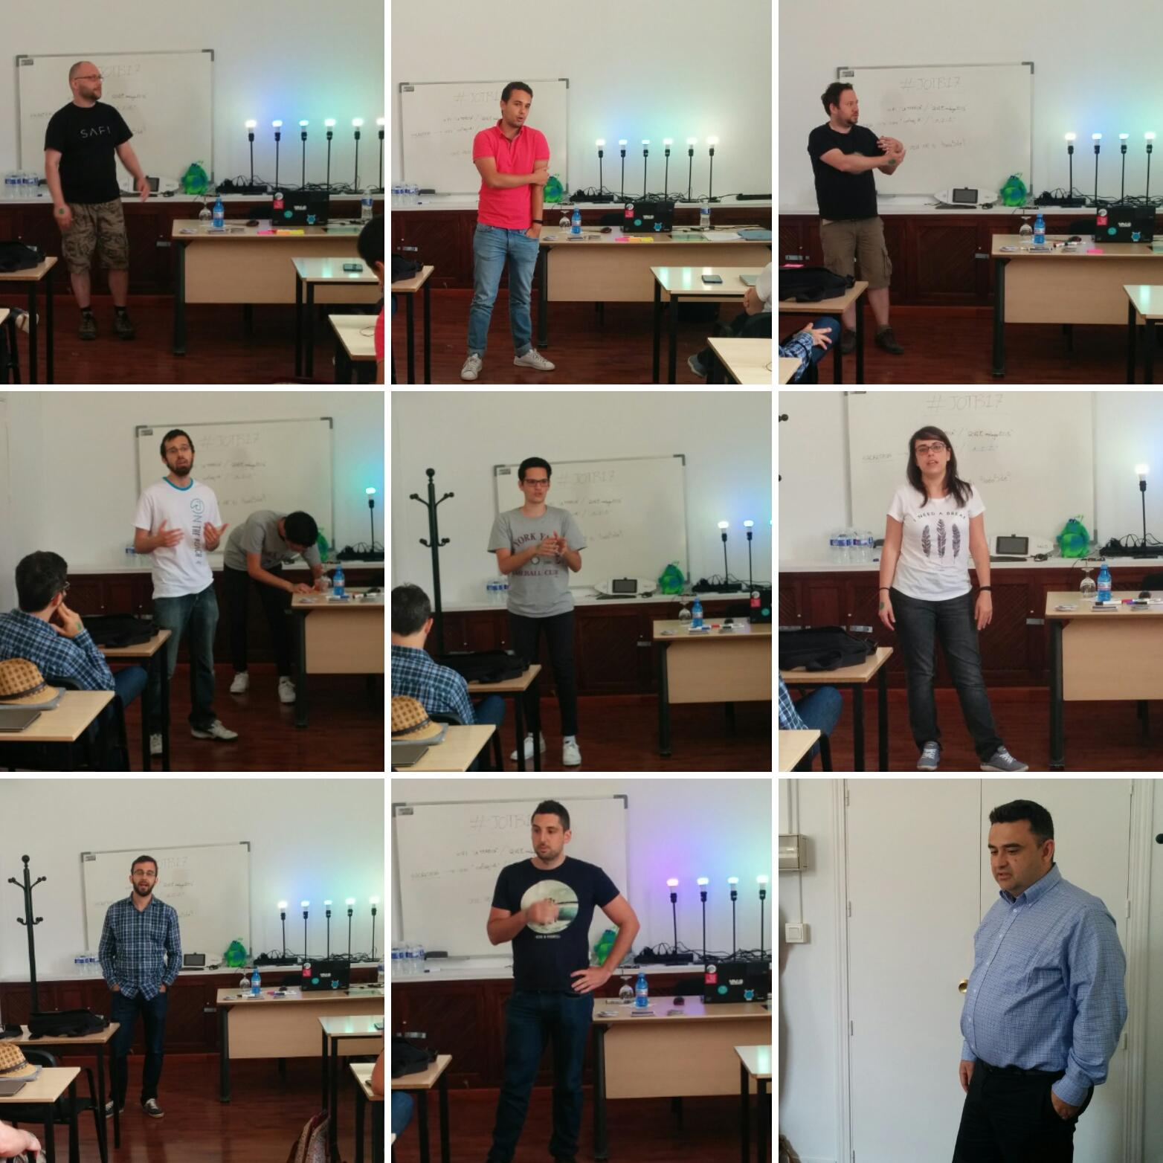
Self introduction

Slide 35
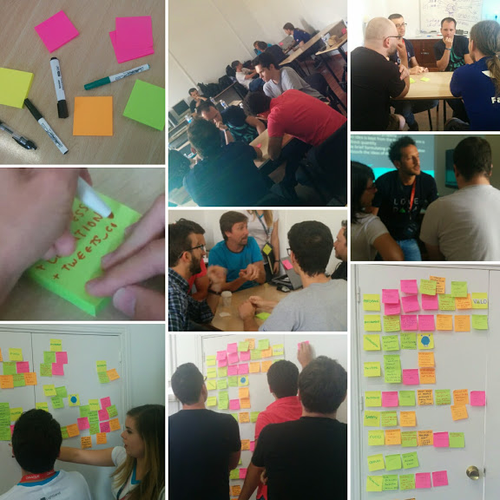
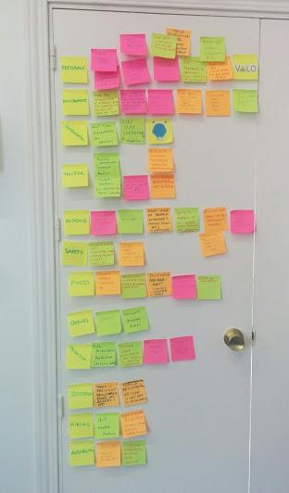
Brainstorm

Slide 36
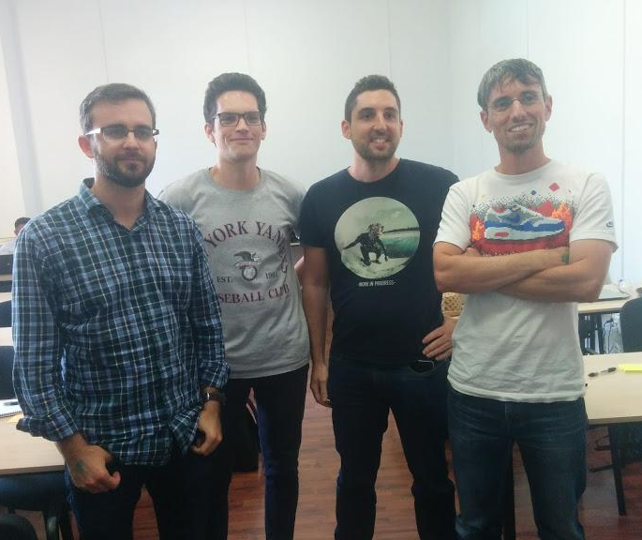
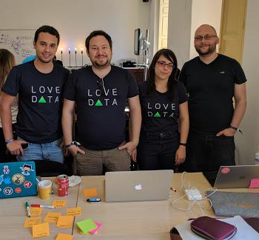
Teams

Slide 37
Let's keep in touch

Slide 38
Thank you!
See you soon!

Slide 39
Criteria
Innovation / business / social impact
Relevance of Internet of Things
Relevance of Real Time Analytics
Working prototype / technical specification
Presentation

